Slide 1

Services and Contributions: valuing nature in a human world
Clara Garcia Ramis, Alexie Kolowrat & Hao Tan

Slide 2

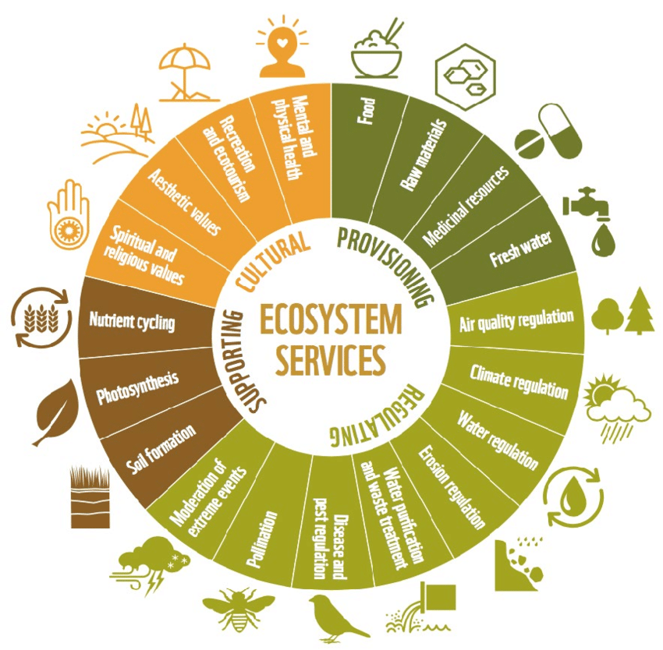
Ecosystem services
Ecosystem Functions
Goods and Services
Direct or indirect impact on human welfare
Four categories of ecosystem services
Exploitation of Ecosystem Services
Decrease in biodiversity
Less resilient ecosystems
Affected human welfare
Bhagwat, Shalmali (2025). WOTR
Notes:
CLARA
Ecosystem functions are the habitat, biological or system properties or processes of ecosystems.
Ecosystem goods and services are the benefits humans get directly or indirectly from ecosystem functions. Not necessarily 1-1 ratio, one service and be the product of multiple functions, one function can contribute multiple resources
Four main categories of ecosystem services:
Provisioning services (products obtained from ecosystems)
Regulating services (benefits derived from the regulation of ecosystem processes)
Supporting services (which support other ecosystem services)
Cultural services (non-material benefits obtained from ecosystems)
Exploitation of ecosystem services leads to the following:
Decrease in biodiversity
Less resilient ecosystems
Affected human welfare
Citations
Bhagwat, Shalmali. “Ecosystem Integrity: Its Role, Challenges and Opportunities.” Welcome to WOTR! - Watershed Organisation Trust (WOTR), 19 Feb. 2025, wotr.org/blog/maintaining-ecosystem-services-and-biodiversity-for-long-term-sustainability-of-ecosystem/. Accessed 5 Dec. 2025.
Costanza, Robert, et al. “The Value of the World’s Ecosystem Services and Natural Capital.” Nature, vol. 387, no. 6630, 15 May 1997, pp. 253–260, https://doi.org/10.1038/387253a0.
Holmes, Amelia. “Natural Capital: Valuing Wild Landscapes.” The Lifescape Project, 2024, lifescapeproject.org/the-natural-capital-framework/.

Slide 3
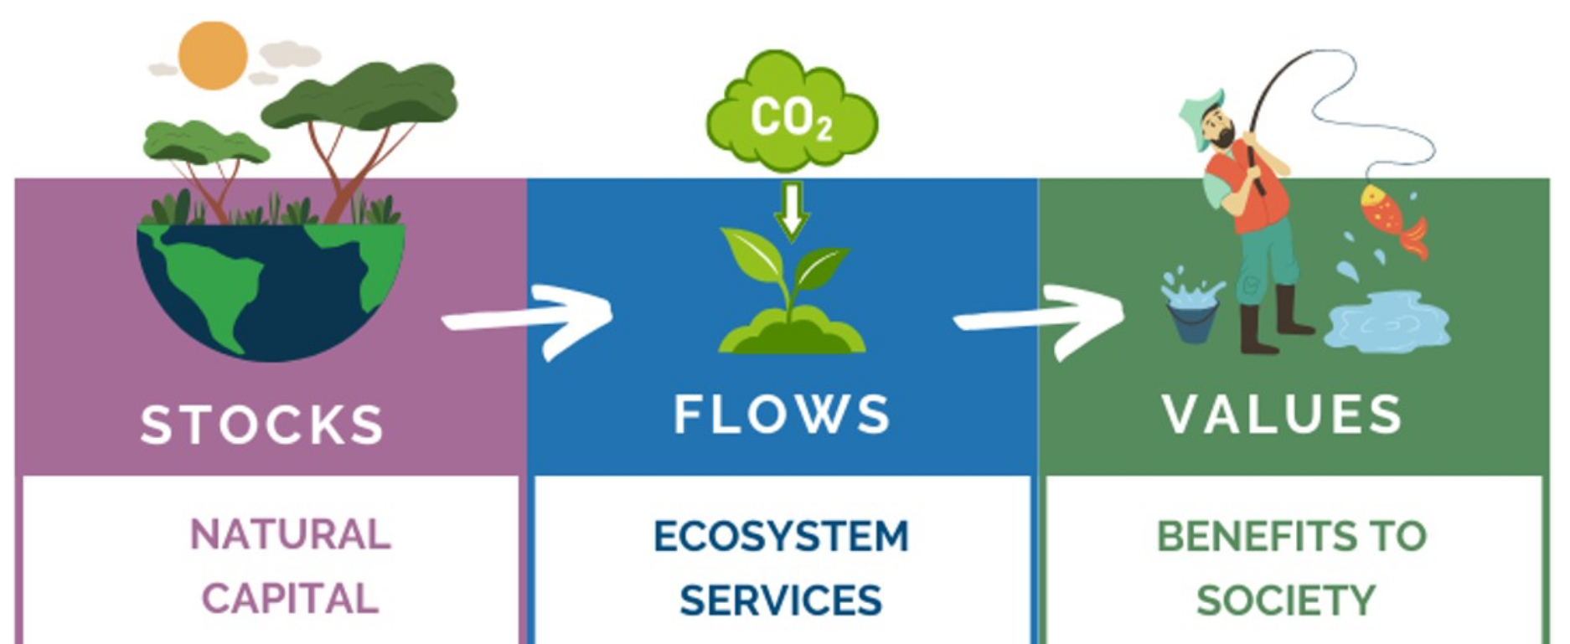
Valuing Natural Capital and Ecosystem Services
-> How much would it cost to technologically replace ecosystem services?
Holmes, Amelia (2024). The Lifescape Project
Notes:
Sasa
Natural capital is a stock of materials or information that independently or interdependently enhance human life through a flow of services that affect materials.
stock - tangible (capital) and intangible (information)
Valuation has a lot of ambiguities but it is inseparable from decision making because when you make a choice about ecological systems you place value on something whether explicitly or not
Value should be infinite because you can’t reproduce it and its essential
Effect of quantity and quality of natural capital and ecosystem services on human welfare ->small changes at large scale and large changes at small scales
Costs/benefits of maintaining human welfare and activity in market and non market ways would be affected
Alternative method: How much would it cost to technologically reproduce ecosystem services? (e.g biosphere II or space missions)
-> for comparison, replacing the services of ecosystems at current margins means increasing GNP by 33 trillion to cover services existing in GNP and those which are not. Welfare would stay the same as we are just replacing existing services (but these services are literally irreplaceable anyway)
Citations:
Díaz, Sandra, et al. “Assessing Nature’s Contributions to People.” Science, vol. 359, no. 6373, 18 Jan. 2018, pp. 270–272, https://doi.org/10.1126/science.aap8826.
Holmes, Amelia. “Natural Capital: Valuing Wild Landscapes.” The Lifescape Project, 2024, lifescapeproject.org/the-natural-capital-framework/.

Slide 4
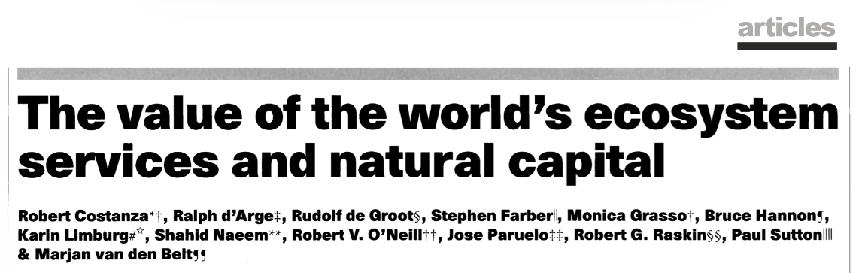
May 15th 1997
A synthesis of literature and calculations to produce a global value of ecosystem services
Method:
17 ecosystem services from 16 biomes
calculate value per unit area
unit value x surface area = global total
Making future studies more accurate
Include a broader range of Ecosystem Services
Represent ecosystem dynamics and interdependence
Study the effect of stress or scarcity of ecosystem services
Goals of the study
Provide a range of possible values/first approximation
Framework that identifies research gaps
Encourage further study
Use of information discovered
Modify systems to reflect value
Project Appraisal
Represent relative importance
Notes:
Sasa
The study synthesized knowledge from literature and performed calculations to produce an estimate for global value of ecosystem services and natural capital that was conducted at the National Center for Ecological Analysis and Synthesis (NCEAS) at UC Santa Barbara.
Natural capital stock that produces ecosystem services needs to be considered in the decision-making process, otherwise welfare will suffer.
Goals of this study:
generate a first approximation
Framework that identifies research gaps
Encourage further study
How can we use the information discovered:
modify systems of national accounting to reflect value of ecosystem services and natural capital
Project appraisal: ecosystem services lost must be weighed against the benefits of a project so they do not go ignored or undervalued
represents relative importance of Ecosystem Services and their impact on our whale fare if we continue diminishing them at this rate.
How to improve this study:
Include a broader range of ecosystem services
Represent ecosystem dynamics and interdependence
Study the effect of stress or scarcity of ecosystem services
To value services:
Distinguished 17 major categories of renewable resources (distinguishing joint/addable products or different aspects of the same service to avoid double counting).
value per unit area
unit area x surface area = global total
Citations:
Costanza, Robert, et al. “The Value of the World’s Ecosystem Services and Natural Capital.” Nature, vol. 387, no. 6630, 15 May 1997, pp. 253–260, https://doi.org/10.1038/387253a0.

Slide 5
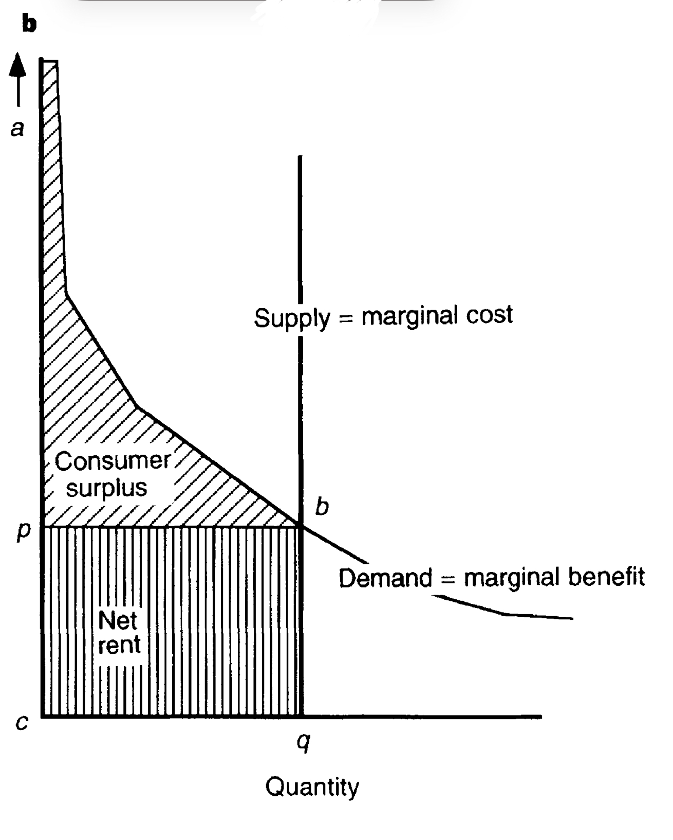
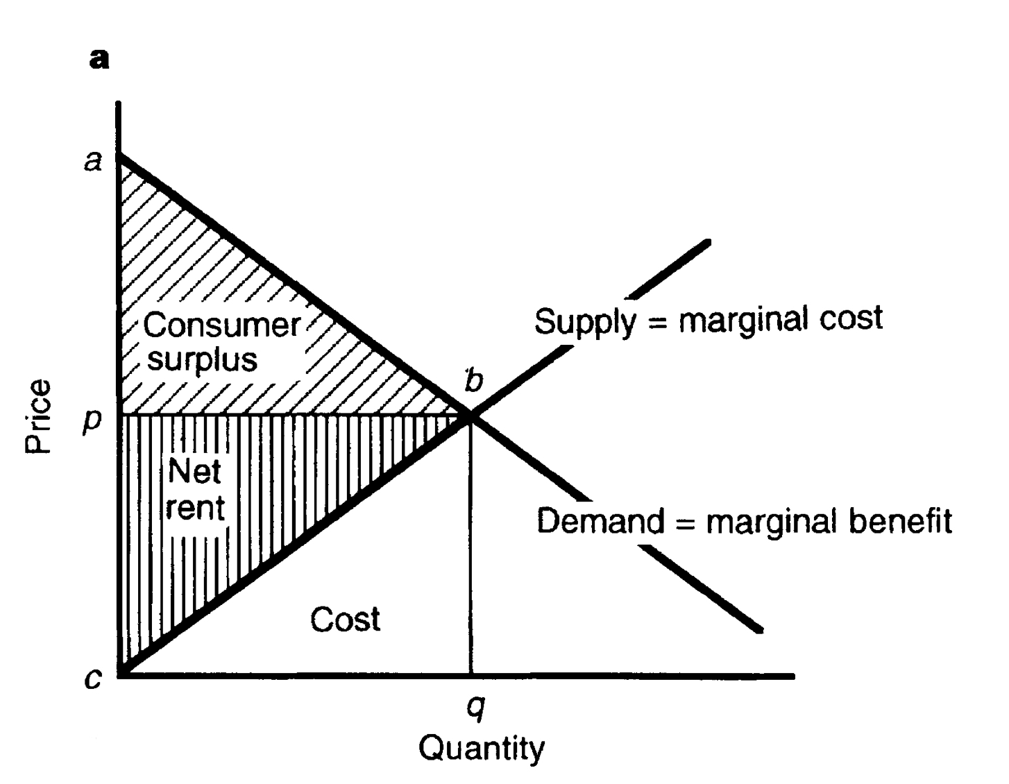
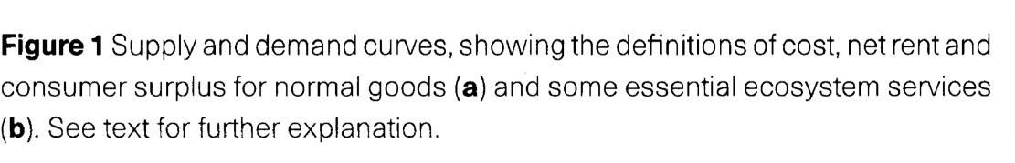
Ecosystem service
Human-made substitutable good
Costanza, Robert, et al. (1997). Nature
Notes:
SASA
The first figure represents a human-made substitutable good
Ecosystem services are only substitutable up to a certain point. Ecosystem services look more like the second figure, demand reaches infinity, quantity available reaches close to zero, and consumer surplus and economic value nears infinity.
Demand curves are nearly impossible to estimate and ecosystem services cannot be increased or decreased by effects of the economic system, their supply curves are close to vertical
Consumer surplus: the economic benefit consumers get when the price they actually pay for a product is less than the maximum price they were willing to pay
Citation:
Díaz, Sandra, et al. “Assessing Nature’s Contributions to People.” Science, vol. 359, no. 6373, 18 Jan. 2018, pp. 270–272, https://doi.org/10.1126/science.aap8826.

Slide 6
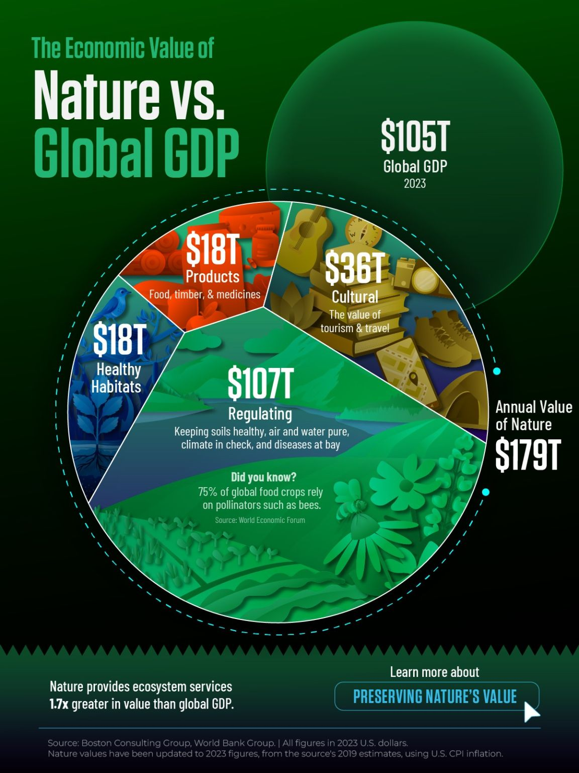
Global Value
Estimated global value:
$16–54 trillion/year, average $33 trillion → ~1.8× global GNP in 1997
Replacing ecosystem services would require increasing GNP by ~$33 trillion in 1997 just to maintain current welfare.
$179 trillion/year → ~1.7× global GDP in 2023, based on 2019 ~2023 datas.
Replacing ecosystem services would require increasing GNP by ~$179 trillion in 2023 just to maintain current welfare.
Notes:
HAO
https://data.worldbank.org/
www.linkedin.com/posts/sustainability-infographics_charted-the-economic-value-of-nature-vs-activity-7317396195935465473-IBC2
The $179 trillion estimate comes from later expanded models, not from the 1997 paper.
Díaz, Sandra, et al. “Assessing Nature’s Contributions to People.” Science, vol. 359, no. 6373, 18 Jan. 2018, pp. 270–272, https://doi.org/10.1126/science.aap8826.

Slide 7
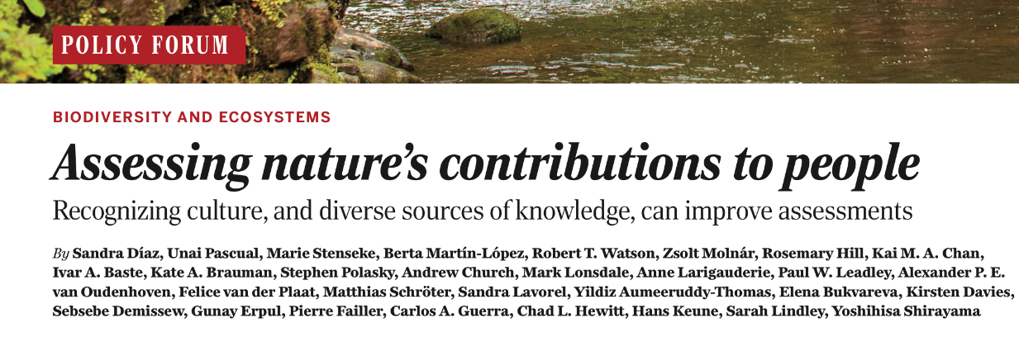
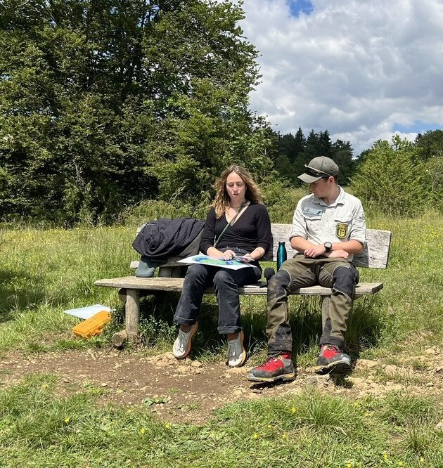

Nature’s contributions to people
January 19th 2018
both positive and negative (Eg. Food provision/Disease transmission)
Cultural context can affect connotation
-Paper focus: need to sustain/improve nature’s beneficial contributions to human quality of life.
Not suitable anymore, too focused on ecology+economy Authors favour NCP instead
The challenge motivated IPBES+MA, a science-policy framework
Primary Difference 1997 vs. 2018:
The role of culture and local knowledge in defining NCPs
((2025) Restauración Ecológica.)
Notes:
CLARA
-The paper focuses on the need to sustain/improve nature’s beneficial contributions to human quality of life.
Intergovernmental Science-Policy Platform on Biodiversity and Ecosystem services (IPBES) wanted to create framework to emphasize the effect of Earth’s Biodiversity and Ecosystems on human welfare to inform policy decision.
Nature’s contributions to people (NCP) is a new concept building off the MA: Millenium Ecosystem Assessment
Not suitable anymore, too focused on ecology+economics. Authors favour NCP instead. NCP builds on MA and IPBES NCP differs in important ways, expanding that framework.
Some cultural ecosystem services can’t have biophysical or monetary metrics
The main difference between the two is the role of culture linking people and nature and emphasis on indigenous and local knowledge in our understanding of NCPs.
The goal was to increase political legitimacy of assessment findings and advance knowledge it is important to include a diverse group of people including natural, social, humanistic, engineering, indigenous and local etc.
Epistemologically diverse evidence can result in richer solutions that benefit nature and people even in large scale assessments.
Different knowledge systems makes IPBES procedures and outcomes increasingly equitable, helping counteract the power dynamic between local and indigenous knowledge and western science
Changing assessment procedures and outcomes -> effort to get local and indigenous knowledge through literature and conversations (e.g. Europe and Central Asia revealing complex interactions of detrimental and beneficial NCP not previously considered (predation on livestock + carcass removal or protection from guard dogs) Enhancing knowledge about the status and trends within the NCP categories
Some NCP defined as practices of care gifted to people (pollinators, pollination, food production example), even though concepts like this don’t fit into a typical category, they underpin messages to policy makers and strengthen the argument
NCP wanted better more legitimate products that are more likely to be incorporated into policy and practice,it emphasizes the importance of diverse perspectives and inclusion including knowledge and representation.
Range of views (human + nature reciprocal or separate)/Cultural lenses of viewing coproduction (human + nature) of NCPs
NCP – Natures contributions to people
Including both positive and negative
Positive eg. Food provision
Negative eg. Disease transmission
Cultural, socioeconomic, temporal or spatial context can affect whether a contribution is seen as positive or negative.
Eg. Carnivores – control wild ungulates but harm livestock
(i.e. high diversity agriculture)
Citation:
Díaz, Sandra, et al. “Assessing Nature’s Contributions to People.” Science, vol. 359, no. 6373, 18 Jan. 2018, pp. 270–272, https://doi.org/10.1126/science.aap8826.
Citation:
“A Metacoupling Lens on the Co-Production of Nature’s Contributions to People: Insights for Sustainability - Restauración Ecológica.” Restauración Ecológica, 25 July 2025, restauracionecologica.csic.es/2025/07/25/a-metacoupling-lens-on-the-co-production-of-natures-contributions-to-people-insights-for-sustainability/. Accessed 5 Dec. 2025.
Díaz, Sandra, et al. “Assessing Nature’s Contributions to People.” Science, vol. 359, no. 6373, 18 Jan. 2018, pp. 270–272, https://doi.org/10.1126/science.aap8826.

Slide 8
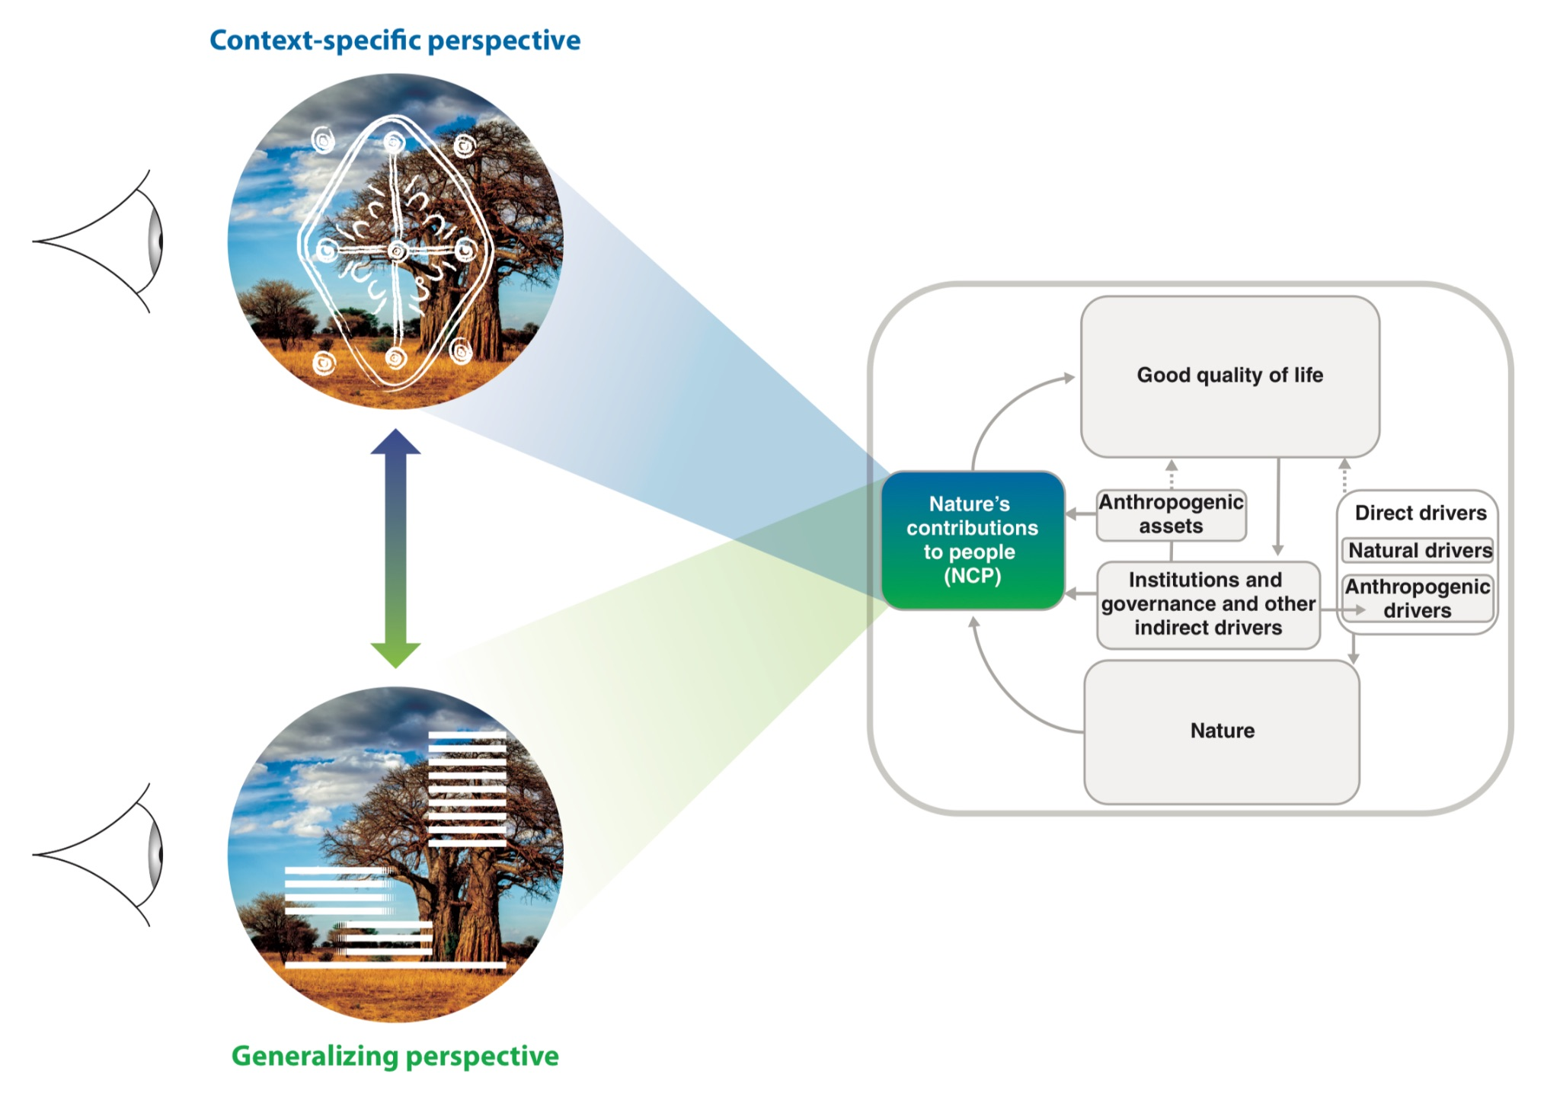
Generalizing and Context Specific perspective
Generalizing (18):
Material Non-Material Regulating
Context-specific: Other human-nature relationships. Distinct lived experiences (farming, fishing etc)
Díaz et al. (2018). Science
Notes:
CLARA
Generalizing and context specific perspective despite seeming are interconnected within disciplines and knowledge systems
18 categories organized in three overlapping groups depending on what functions they perform for human well-being.
Generalizing Perspective -> natural sciences and economics
seeks categories for flows of nature to people
Sharp distinction
Only people have autonomy
A system comprised of 18 groups within regulating, material and nonmaterial NCP defined by effect on human welfare
- Culture is included in all groups not just “cultural ecosystem services” like in MA.
- The categories overlap, grouped only for practicality (i.e. food is material but it has non material benefits too)
Context-Specific perspective -> local and Indigenous knowledge systems
-Context-Specific perspective ensures inclusion and no forced categorization allowing for cooperation across knowledge systems in co-construction of knowledge for sustainability
-Resist universally applicable schema, does not seek or validate itself beyond geographical or cultural context
-NCPs are comprised of distinct lived experiences and cultural incommensurability and resistance to universal perspectives on human-nature relationships makes them resilient to classification
Citation:
Díaz, Sandra, et al. “Assessing Nature’s Contributions to People.” Science, vol. 359, no. 6373, 18 Jan. 2018, pp. 270–272, https://doi.org/10.1126/science.aap8826.

Slide 9
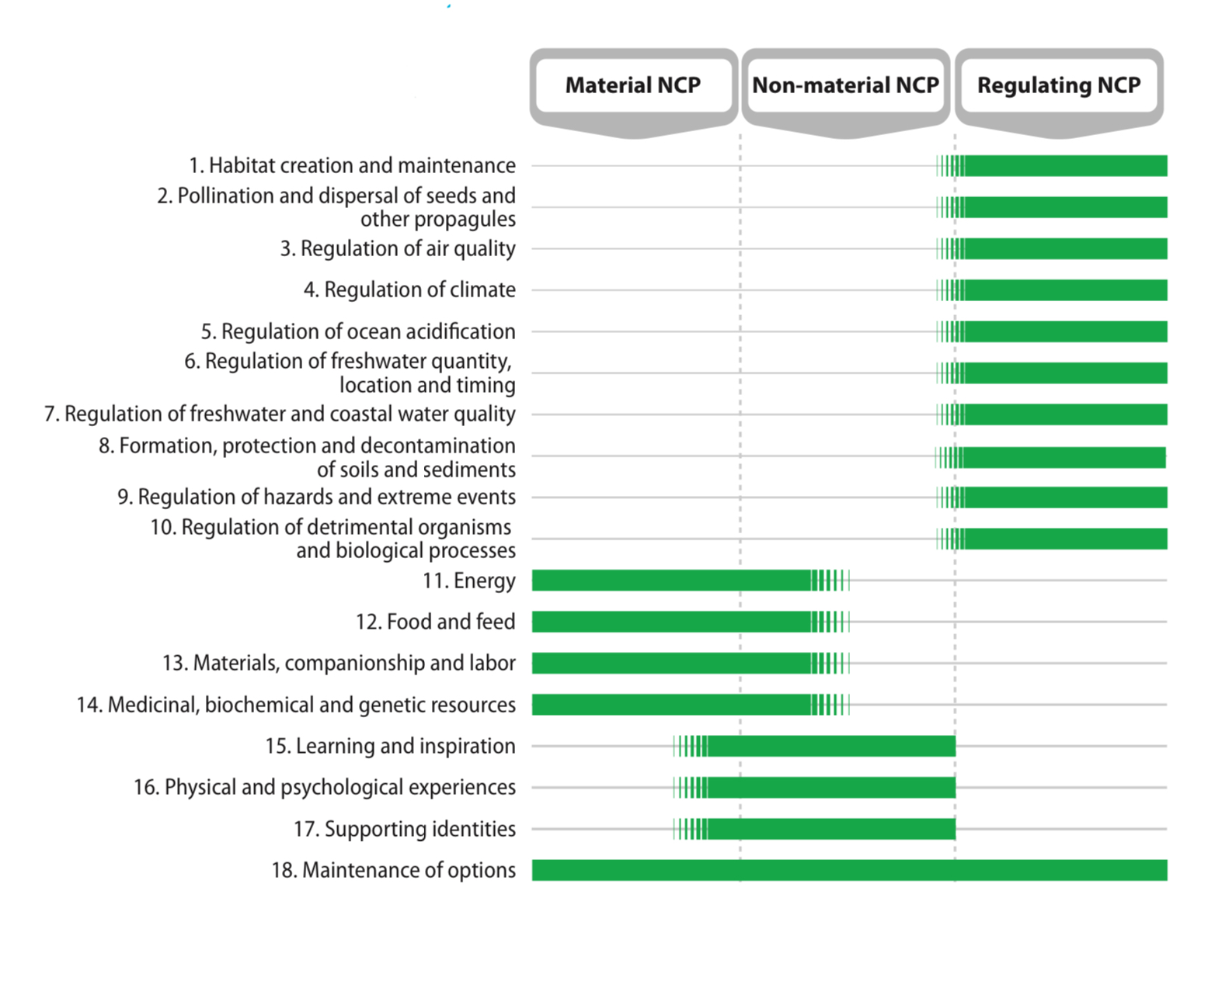
Generalizing categories of the NCP System
Material: material elements physically consumed and directly sustaining welfare
Non-material: subjective or psychological welfare
Regulating: affect welfare in indirect ways
Goal of these developments:
Increase political legitimacy and knowledge in policy through diverse perspectives
Díaz et al. (2018). Science
Notes:
CLARA
Material -> material elements that directly sustain life and assets, physically consumed while experienced (e.g. food into organisms or energy)
Nonmaterial -> natures effects on subjective or psychological welfare individually and collectively, recreation and inspiration or spiritual/ social-cohesion experience
Regulating -> functional and structural organisms and ecosystem factors the effect material and nonmaterial production or environmental conditions, affect quality of life in interdict ways (soil organisms providing nutrients for pretty plants)
Citation:
Díaz, Sandra, et al. “Assessing Nature’s Contributions to People.” Science, vol. 359, no. 6373, 18 Jan. 2018, pp. 270–272, https://doi.org/10.1126/science.aap8826.

Slide 10
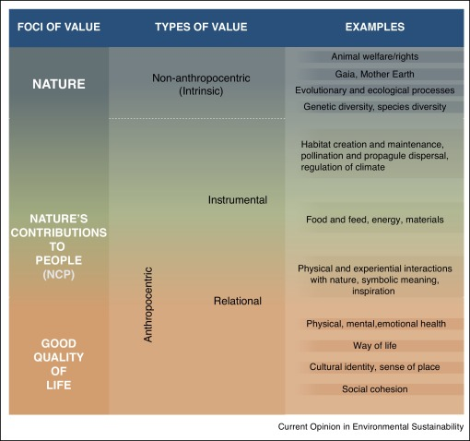
Intrinsic, instrumental and relational value
Intrinsic - The inherent value of nature independent of benefits it provides humans
Instrumental - The benefits nature provides to human welfare
Relational - Reciprocal relationships between humans and nature
Vestibulum congue
2024 Why Nature Matters , Bioscience
Notes:
SASA
Intrinsic - The inherent value of nature independent of benefits it provides humans
Instrumental - The benefits nature provides to human welfare
Relational - Reciprocal relationships between humans and nature
Citation:
Austin Himes, Barbara Muraca, Christopher B Anderson, Simone Athayde, Thomas Beery, Mariana Cantú-Fernández, David González-Jiménez, Rachelle K Gould, A P Hejnowicz, Jasper Kenter, Dominic Lenzi, Ranjini Murali, Unai Pascual, Christopher Raymond, Annalie Ring, Kurt Russo, Aibek Samakov, Sanna Stålhammar, Henrik Thorén, Egleé Zent, Why nature matters: A systematic review of intrinsic, instrumental, and relational values, BioScience, Volume 74, Issue 1, January 2024, Pages 25–43, https://doi.org/10.1093/biosci/biad109

Slide 11
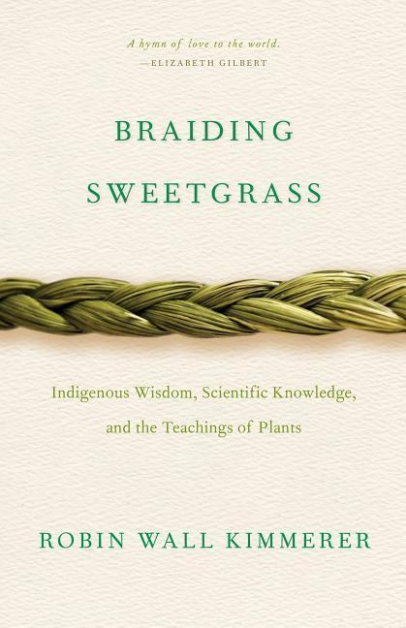
Indigenous and Local Knowledge
“Action on behalf of life transforms. Because the relationship between self and the world is reciprocal, it is not a question of first getting enlightened or saved and then acting. As we work to heal the earth, the earth heals us.”
"Give a gift, in reciprocity for what you have taken. Sustain the ones who sustain you and the earth will last forever...”
Vestibulum congue
Kimmerer, Robin Wall (2013). Braiding Sweetgrass
Notes:
SASA
Indigenous knowledge -> reciprocal/relational relationship
Citation:
Kimmerer, Robin Wall. Braiding Sweetgrass. Braiding Sweetgrass: Indigenous Wisdom, Scientific Knowledge and the Teachings of Plants, Minneapolis, Minnesota, Milkweed Editions, 2013.
Roué, Marie, and Zsolt Molnar. Knowing Our Lands and Resources. UNESCO Publishing, 3 Apr. 2017.

Slide 12
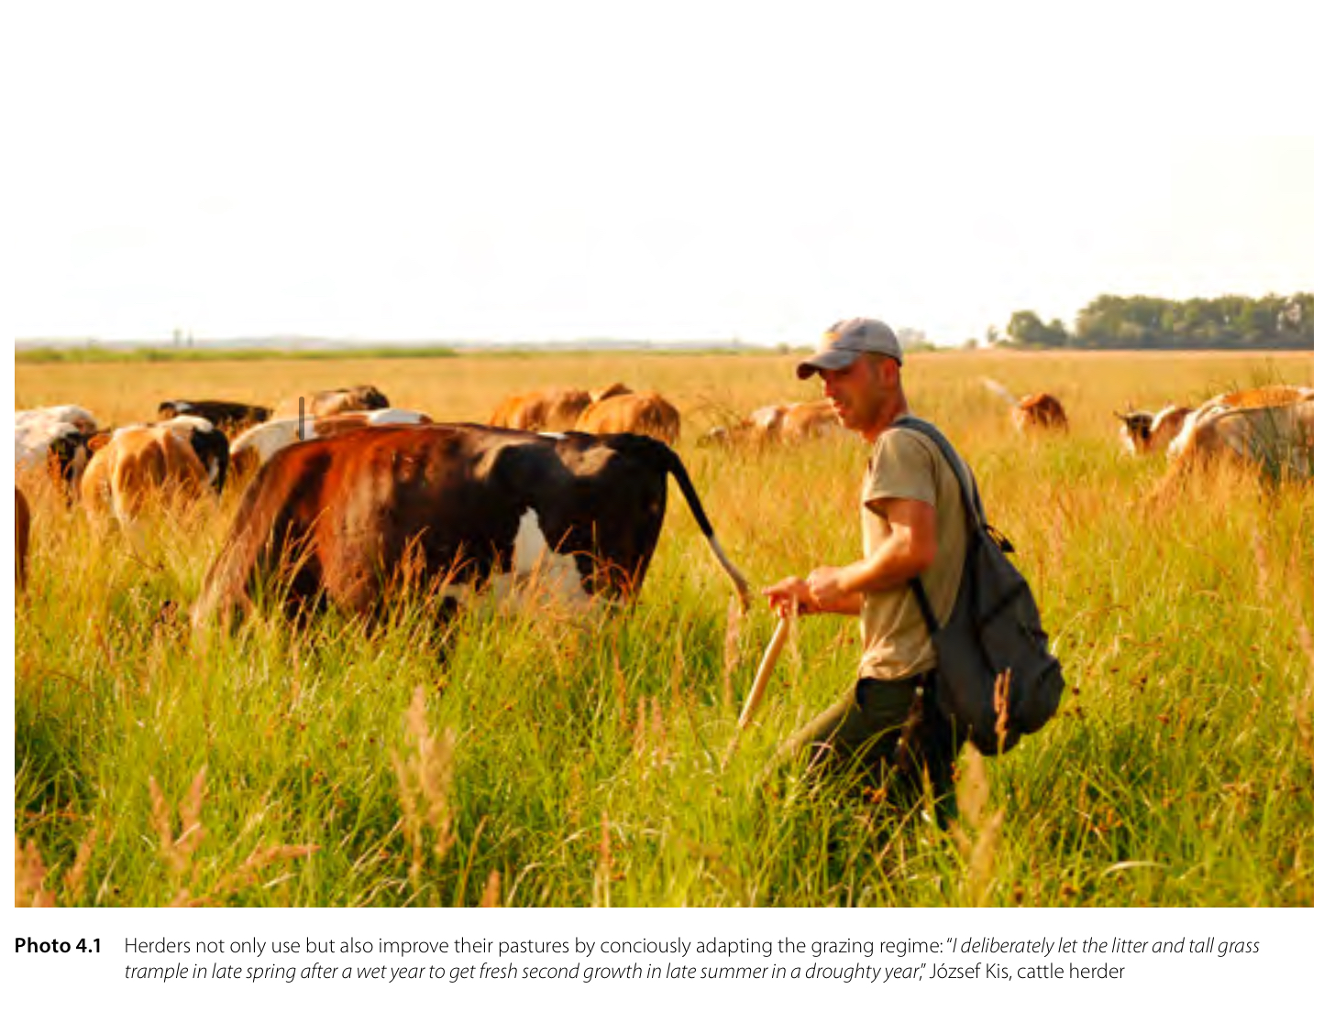
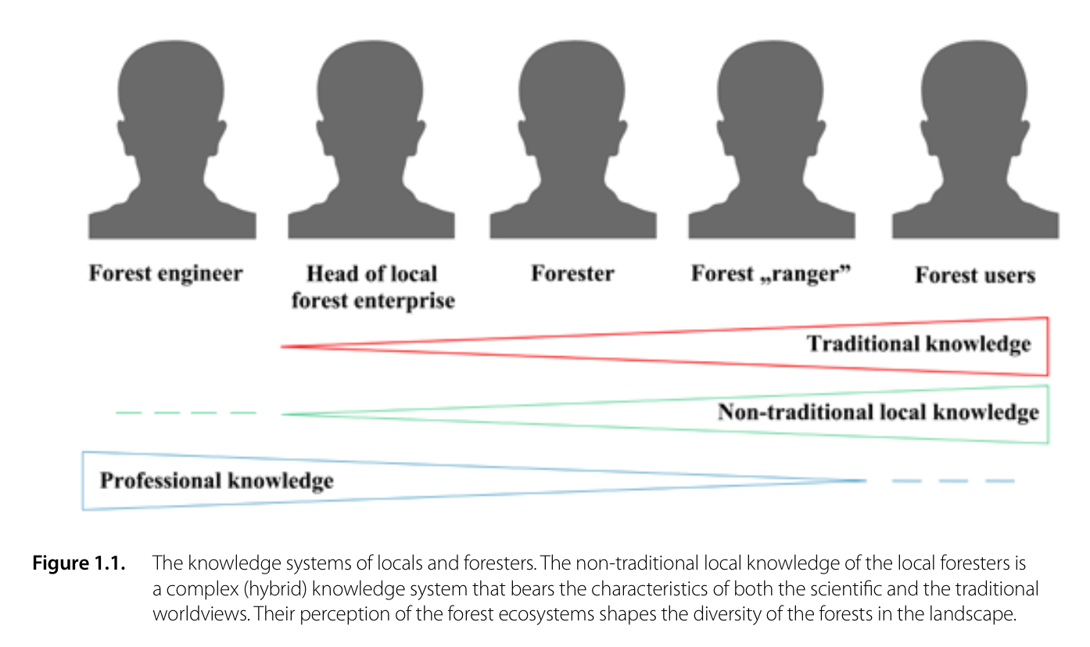
Indigenous and Local Knowledge
Vestibulum congue
Roué, Marie, and Zsolt Molnar (2017). Knowing Our Lands and Resources
Notes:
SASA
Invaluable contribution of local knowledge to data
Hungarian herder ecological knowledge
deep ecological knowledge about nature -> local habitat needs and biological properties of local organisms
Effectively utilize and preserve and increase productivity of grasslands + restore degraded areas, contribute to survival of bird and plant species
Shrubs, pioneer forests and invasive species may outcompete threatened species from areas where grazing has been abandoned.
preserving culture and adapting new practices, sustainable use of ecosystem services and preserving biodiversity, while producing quality meat products
Preservation of grassland diversity and ecosystem services
Ecological herder job developed
Ukrainian forest knowledge
forest resources are the livelihood of local community, locals understand the ecosystem services and biodiversity
“Local foresters and rangers recognise and give explanations to the structural and
species compositional changes (proportion of mixture species, spread of invasive species, etc.) occurring in the forest, and their natural (e.g. climate change) and social-economic (migration, economic recession, etc.) driving forces.”
“The local forester, under the influence of his traditional and scientific worldview about the forest, makes his decisions often as a kind of “resiliency manager”, keeping in mind the interests of the state, the forest and the local population.”
reforming the forestry sector to involve local communities in decisions about forest management
Citation:
Kimmerer, Robin Wall. Braiding Sweetgrass. Braiding Sweetgrass: Indigenous Wisdom, Scientific Knowledge and the Teachings of Plants, Minneapolis, Minnesota, Milkweed Editions, 2013.
Roué, Marie, and Zsolt Molnar. Knowing Our Lands and Resources. UNESCO Publishing, 3 Apr. 2017.

Slide 13
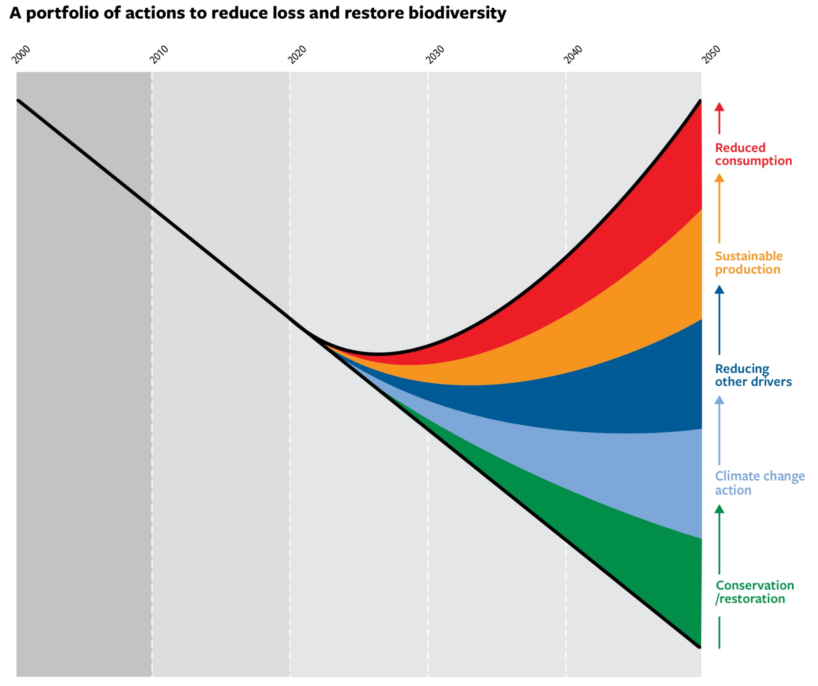
Aichi Targets
20 targets aiming to meet 5 overarching goals
Address underlying causes
Reduce pressure, promote sustainability
Safeguard ecosystems, species and diversity
Highlight and improve benefits of ecosystem services
Expand knowledge management and capacity building
Lai, Olivia (2021). Earth.org
Notes:
SASA
Multiple worldviews and diverse expression, like aichi targets, show how inclusive framings improve political legitimacy and implementation of international objectives.
20 targets set by UN convention of biodiversity to address and mitigate biodiversity loss. (2011) Working to meet five overarching goals
Address underlying causes in order to prioritize
education
local development and poverty reduction
harms eliminated and positive incentives promoted in policy
sustainable production and consumption
Reduce direct pressures and promote sustainable use
Reduce natural habitat loss
Sustainable fish and invertebrate stocks
Sustainable agriculture, aquaculture, and forestry
Pollution decreased
Invasive species under control
Coral reefs/valuable ecosystems protected
Safeguard ecosystems, species and diversity
Protected landscapes and Seascapes
Prevent extinction of threatened species
Genetic diversity of plants and animals sustained
Highlight and improve benefits from ecosystem services
restore and safeguard ecosystems that provide essential services
climate change mitigation through ecosystem resilience and contributions to biodiversity
genetic resources
Expand knowledge management and capacity building
Biodiversity strategy and action plan
Participation of local and global communities
Extinction rates are rapidly increasing-1 million currently at risk, never been higher and it’s due to our activity that affects habitats.
Some targets were set for 2015, others for 2020, the key summit to review the targets was pushed back due to covid so the review was not conducted until October 2021.
Progress: 44% of biodiverse areas are now protected, which is an increase from the 29% in 2000, in addition 200 invasive species have been able to be eradicated.
Citations:
Lai, Olivia. “What Are the Aichi Biodiversity Targets?” Earth.org - Past | Present | Future, 11 Oct. 2021, earth.org/what-are-the-aichi-biodiversity-targets/.

Slide 14
May 15th 1997
January 19th 2018
Goals of the paper/study | Attempting to place value on nature, general framework | Rework the framework to include diverse perspectives to improve assessments
Type of study | Literature review with additional calculations | Conceptual work / Theory paper
Treatments on ecosystem goods and services | Grouped goods and services together | Separating goods and services
Emphasis | Natural Science and Economics | Social Sciences and Humanities
Notes:
HAO
1997:
Stock and flow, mutual alienation of certain perspectives, voluntary self exclusion leading to less perspectives.
Natural sciences- ecological production function to determine supply of services as flows from ecosystems
Economics- monetary value to ecosystem services, identify trade-offs and impact on well-being
Pushback due to concerns about the commodification of nature and Social Equity.
More Narrow, market based
2018:
Social Science and humanities: Local and indigenous knowledge
Inclusive in terms of knowledge and representation
Citations:
Costanza, Robert, et al. “The Value of the World’s Ecosystem Services and Natural Capital.” Nature, vol. 387, no. 6630, 15 May 1997, pp. 253–260, https://doi.org/10.1038/387253a0.
Díaz, Sandra, et al. “Assessing Nature’s Contributions to People.” Science, vol. 359, no. 6373, 18 Jan. 2018, pp. 270–272, https://doi.org/10.1126/science.aap8826.

Slide 15
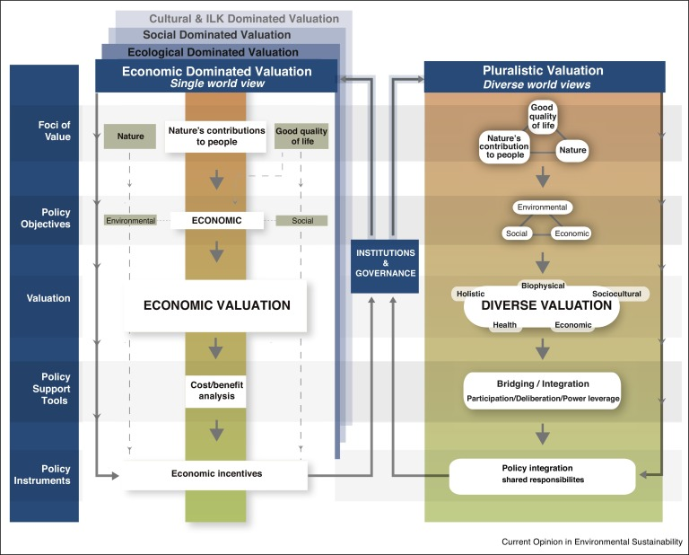
2024 Why Nature Matters , Bioscience
Notes:
SASA

Slide 16
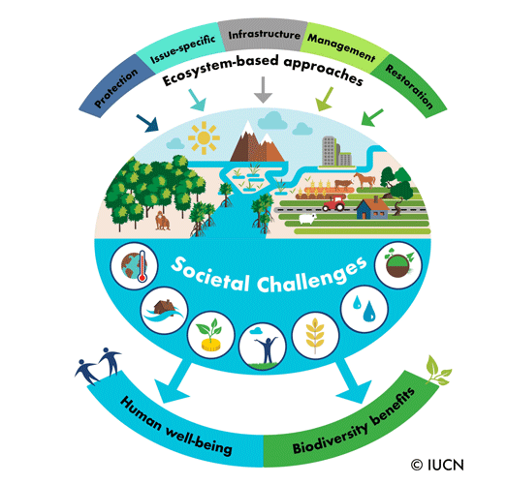
Nature-based solutions (NbS)
The use of Ecosystem-based approaches to address societal challenges to improve biodiversity and human welfare.
Notes:
SASA
International Union for Conservation of Nature approach on Nature Based Solutions
Addressing societal challenges through protection, sustainable management and restoration of ecosystems to improve biodiversity and human welfare
Address global challenges: climate change, human health, food and water security, natural disasters and biodiversity loss
Efficiency needs to increase because projects need to be large enough to be included in policy and be effective (could solve up to 37% of climate change mitigation needs!)
Nature based solutions can decrease the impact of disasters making communities more resilient
Example: Mangroves
Application: 2/3 of governments that are in the Paris Climate agreement have nbs in their plans
Citation:
IUCN. “Ensuring Effective Nature-Based Solutions.” Iucn.org, July 2020, iucn.org/resources/issues-brief/ensuring-effective-nature-based-solutions.

Slide 17
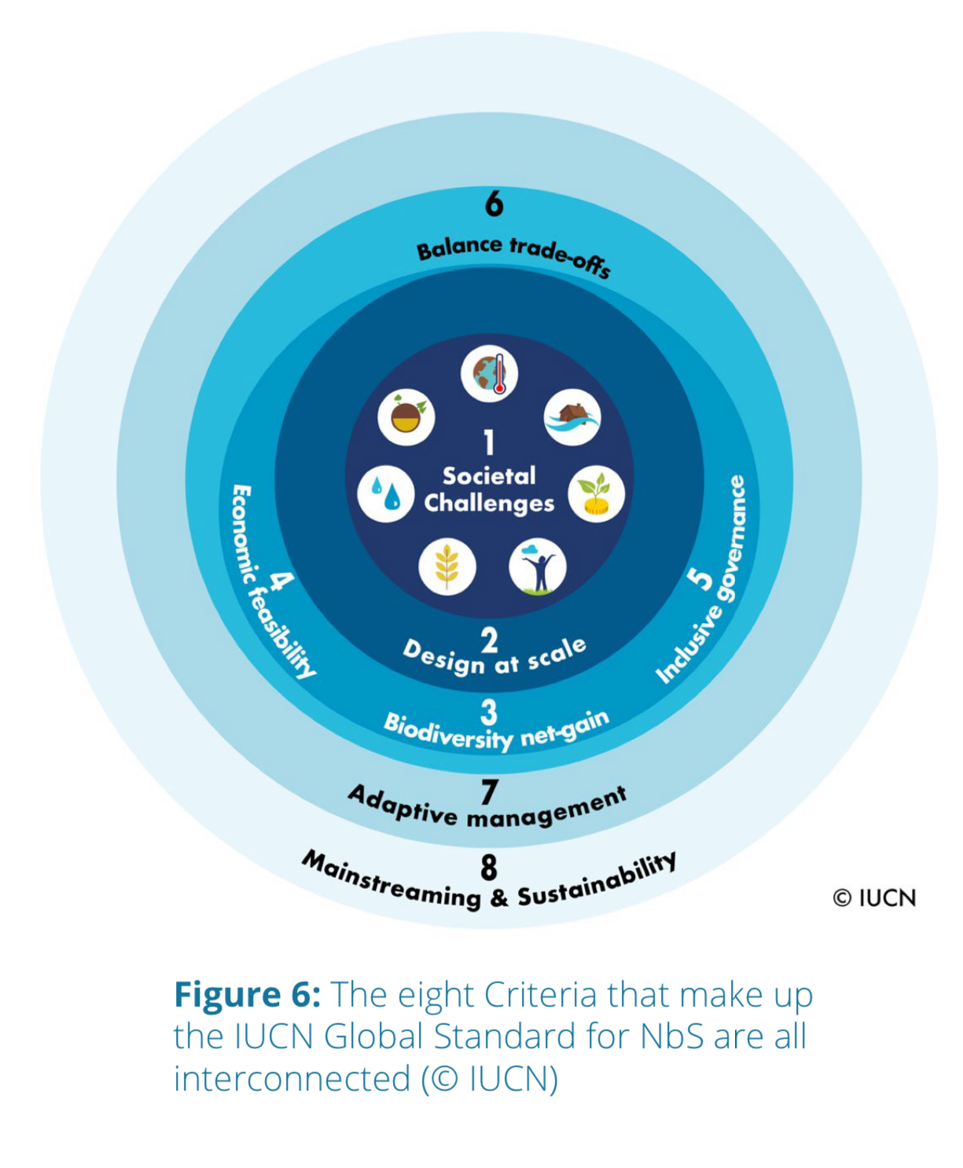
Criteria for Nature-based solutions (NbS)
Importance of criteria
Implementers design effective projects with reasonable scale and sustainability
Investors minimize risk and increase security.
Notes:
SASA
Nature based solutions focus on safeguarding society while following conservation norms that safeguard biodiversity for its irreplaceable value. Not all conservation intentions are nature based solutions. Criteria for Nature Based Solutions addressing the pillars of sustainable development (biodiversity, economy and society) and resilient project management.
Effectively addresses societal changes
Design informed by scale
Results in a net gain of biodiversity and ecosystem integrity
Economically viable
Based on inclusive, transparent and empowering governance processes
Equitably balance tradeoffs between achievement of goals and primary benefits and continued provisions of multiple benefits
Managed adaptably and based on evidence
Sustained and mainstreamed with an appropriate jurisdictional context
Implementers of NBS-> design effective NBS projects with appropriate scale and sustainability
Donors and financiers -> minimize risk and increase security
A poorly managed project can lead to mistrust in the NBS approach, with this criteria we can maximize potential and minimize harm.
Citation:
IUCN. “Ensuring Effective Nature-Based Solutions.” Iucn.org, July 2020, iucn.org/resources/issues-brief/ensuring-effective-nature-based-solutions.

Slide 18
Conclusions
Nature values both in the economic field and social levels.
The older paper takes the notion of natural services and emphasis the importance of nature’s contribution on human welfare. This notion was pioneering for the society which still seems nature’s contribution as free backgrounds, and introduce the concept of natural value to economic consideration.
The later paper emphasizes that nature’s contributions cannot be captured by economic metrics alone; they include relational, cultural, and indigenous knowledge perspectives that are essential to human well-being. This approach transcends a few body of knowledge, expands ecology’s interdisciplinarity in sociology domain.
Notes:
Hao

Slide 19
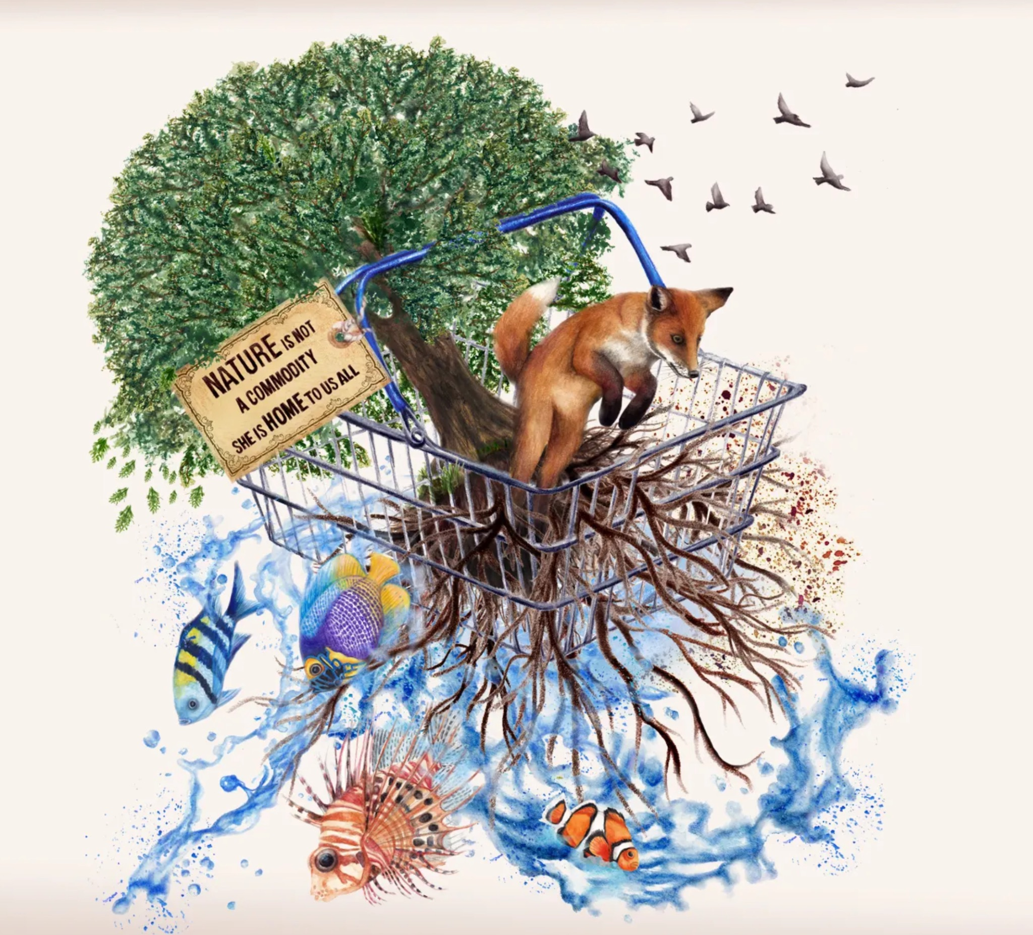
Synthesis
It’s essential to acknowledge the incomparable value of ecosystems and their services
NCP produces results that are both scientifically accurate and more socially accepted, increasing the chance of policy adoption.
Dilworth, Amanda (2025). Dribbble
Notes:
Hao
Image:
Dilworth, Amanda. World Nature Conservation Day Artwork, 2025, dribbble.com/shots/16007802-World-Nature-Conservation-Day-Artwork.

Slide 20
Sources
Scientific Papers provided:
Costanza, Robert, et al. “The Value of the World’s Ecosystem Services and Natural Capital.” Nature, vol. 387, no. 6630, 15 May 1997, pp. 253–260, https://doi.org/10.1038/387253a0.
Díaz, Sandra, et al. “Assessing Nature’s Contributions to People.” Science, vol. 359, no. 6373, 18 Jan. 2018, pp. 270–272, https://doi.org/10.1126/science.aap8826.

Slide 21
Supplementary Sources:
“A Metacoupling Lens on the Co-Production of Nature’s Contributions to People: Insights for Sustainability - Restauración Ecológica.” Restauración Ecológica, 25 July 2025, restauracionecologica.csic.es/2025/07/25/a-metacoupling-lens-on-the-co-production-of-natures-contributions-to-people-insights-for-sustainability/. Accessed 5 Dec. 2025.
Bhagwat, Shalmali. “Ecosystem Integrity: Its Role, Challenges and Opportunities.” Welcome to WOTR! - Watershed Organisation Trust (WOTR), 19 Feb. 2025, wotr.org/blog/maintaining-ecosystem-services-and-biodiversity-for-long-term-sustainability-of-ecosystem/. Accessed 5 Dec. 2025.
Dilworth, Amanda. World Nature Conservation Day Artwork, 2025, dribbble.com/shots/16007802-World-Nature-Conservation-Day-Artwork.
Holmes, Amelia. “Natural Capital: Valuing Wild Landscapes.” The Lifescape Project, 2024, lifescapeproject.org/the-natural-capital-framework/.
IUCN. “Ensuring Effective Nature-Based Solutions.” Iucn.org, July 2020, iucn.org/resources/issues-brief/ensuring-effective-nature-based-solutions.
Kimmerer, Robin Wall. Braiding Sweetgrass. Braiding Sweetgrass: Indigenous Wisdom, Scientific Knowledge and the Teachings of Plants, Minneapolis, Minnesota, Milkweed Editions, 2013.
Lai, Olivia. “What Are the Aichi Biodiversity Targets?” Earth.org - Past | Present | Future, 11 Oct. 2021, earth.org/what-are-the-aichi-biodiversity-targets/.
Roué, Marie, and Zsolt Molnar. Knowing Our Lands and Resources. UNESCO Publishing, 3 Apr. 2017.

Slide 22

Contributions:
Clara - Ecosystem services, modern and classic paper review and valuation process
Alexie - Slides & Citations
Hao - Global Value, literature comparison, conclusion
No AI was used in the making of this presentation
Dan Engler (2018). Charlotte Lozier Institute

